Slide 1
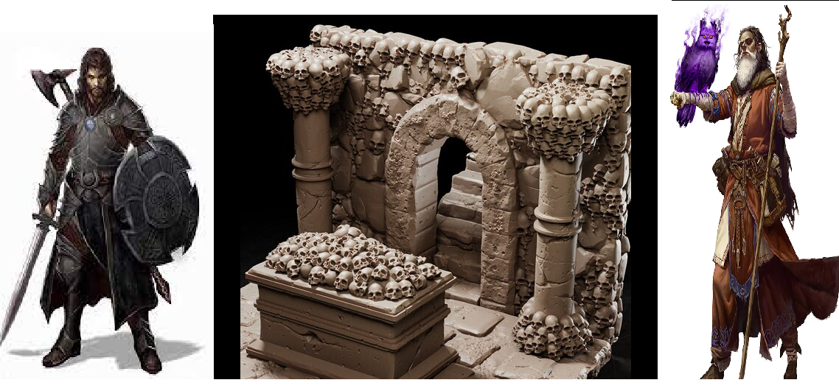
The Adventure of Salvatore
Pitch Date: October 22, 2023 Update November 5, 2023
Release Date: March 3, 2024 Commits: 30 (+7)
Team Lead: Vince McKeown 3 Contributor
1
2
3
4
5
6
7
8
9
10
11
12
13
14
15
16
17
18
19
Done

Slide 2
Contributions This week -Vince McKeown
Player drawn NW, and NE, completing all 8 directions
Added fireplace, coin, healing potion, and speed potion
Added affect of speed potion

